Slide 1
Alaska Department of
Transportation & Public Facilities
Sustainable Construction Practices:
An Owner Perspective
Marc Luiken –Commissioner
Oct 31, 2016

Slide 2
Overview: Impacts to Sustainable Construction
Procurement Methods:
  Construction Manager General Contractor (CMGC)
  Design Build (DB)
Additional Considerations
  Award Timing
  Availability and Cost of Commodities
  Location of Utility Corridors
  Material Sites
2
Notes:
Project delivery is important across the country. Getting projects from design to construction in the most expeditious manner is incredibly important for any project owner. Designing projects to get them through the construction process as efficiently as possible is especially important in Alaska due to our short construction seasons. I’d like to focus my remarks today to a discussion of alternative procurement processes that we have employed in the last few years that supports efficient design, encourages cooperation and collaboration between owner and contractor, mitigates risk, accelerates aand ultimately reduces costs.
I’ll spend most of my time on the Construction Manager/General Contractor procurement process, and provide some examples.
Then we’ll look at the Design Build process with a couple of examples.
Finally, I’ll wrap up with a few additional considerations that we explore to help improve our procurement and construction practices in the Arctic.

Slide 3
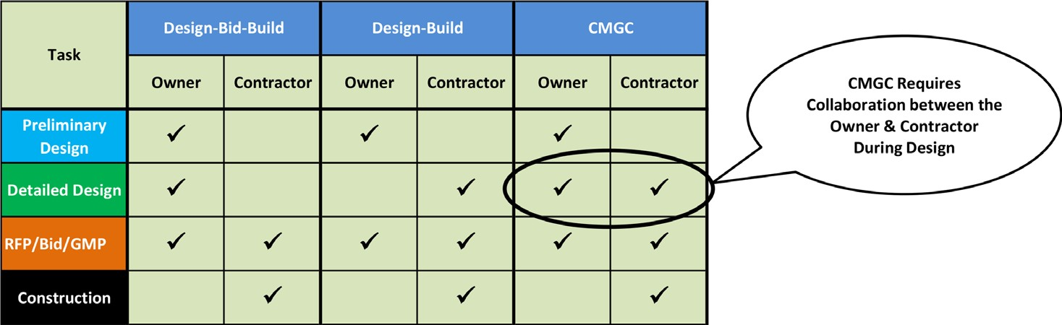
Delivery Method Comparison
*
*Requires Commissioner Approval
Notes:
This graphic just shows who is responsible for specific tasks along the design to construction continuum. The advantage both Design Build and CM/GC offer is a collaborative approach to design and construction between the owner and the contractor, more so with CM/GC . Let’s take a look at CM/GC and how we have used this procurement process successfully in recent years.

Slide 4
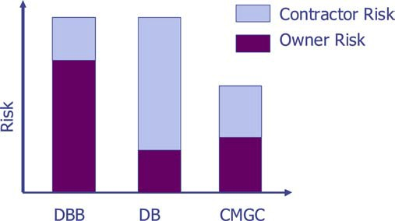
CMGC: The Difference is Risk
Contractor assists in identifying, tracking, and eliminating risks
Project risks can be eliminated, minimized, or assigned and accepted.
Graphic Source: Utah Department of Transportation
Notes:
What makes the CMGC procurement method a preferable choice is the likelihood of risk reduction for both the owner and the contractor. This collaborative approach to risk assessment and mitigation creates comes from a combined effort to shared and reduced risk.

Slide 5
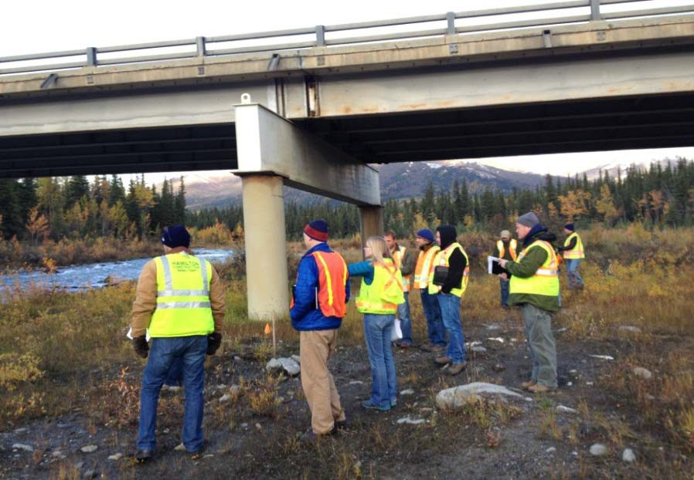
CMGC: Team Approach
Owner DOT&PF
Contractor
CMGC Assistance &
Independent Cost Estimator (ICE)
This procurement method drives the owner, contractor and ICE relationship to work together as a team on design and construction
Notes:
Because both owner, contractor and ICE team to find the quality solutions in design and construction.

Slide 6


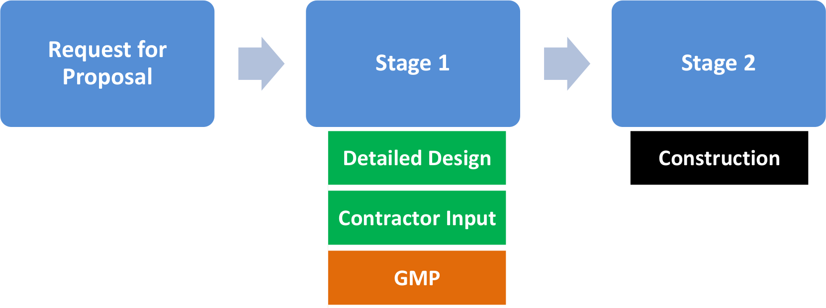
CMGC: Project Development Stages
Preconstruction
Notes:
Here are the steps in the CM/GC process. Often the owner will begin with a request for qualifications to reduce the number of contractors willing or able to make an offer on a RFP. Once a contractor is chose, based on qualification and best offer, the owner and contractor begin a team effort in detailed design.

Slide 7
Stage 1: Contractor Input
Design alternatives
Constructability
Scheduling
Traffic control
Material availability
Risk management
Agency coordination
Permitting
Storm water management
Innovative products
Notes:
The contractor as a partner in the design process has input into all of these detailed design and pre-construction aspects. With both parties working toward a common final design, there is quite a bit of collaboration and transparency on estimated costs.

Slide 8




Stage 1: Pricing Overview
Fair price strategy used to arrive at
Final Phase - Construction
OWNER
Engineer’s estimate
  Typically based on historical data
Contractor Estimate
  Cost and mark-up identified separately
  Some items bid in RFP
Independent Cost Estimate (ICE)
  Cost validation
  “Competing Contractor” approach
ICE
CMGC
Owner controls flow of information.
Unit Price, Guaranteed Maximum Price, or blend (Schedule of Values) can be used.
Notes:
Ultimately, toward the end of final design a Guaranteed Maximum Price will be coordinated. This is where the ICE becomes an essential part of the process. The ICE works with both the owner and the contractor weighing owner Engineer’s estimate with the Contractor Estimate. In the end, they validate a final Unit Price, GMP or recommend a blend between the two, known as a Schedule of Values.

Slide 9
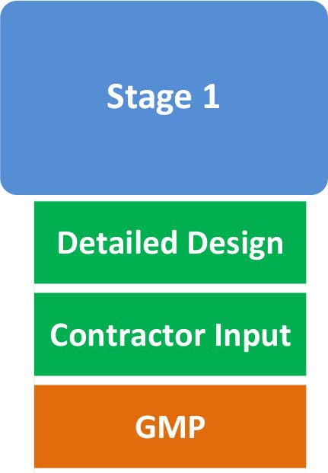
Stage 1: GMP
DOT&PF, ICE, and Contractor
develop Guaranteed Maximum Price (GMP)
Agreement reached – proceed to construction
No agreement reached – proceed to competitive bid
Notes:
In the end, if a agreed GMP cannot be reached, the owner has the option to proceed to a competitive bid, with the final detailed design.

Slide 10
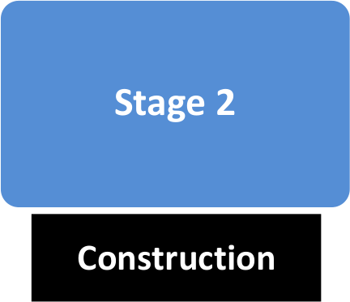
Stage 2: Construction
Begins with acceptance of Construction Cost
  Bid award recommendation
  NTP
CMGC builds, DOT&PF administers contract similar to Design-Bid-Build
Notes:
After completion of the construction cost, GMP, construction begins in earnest, with contractor and owner filling typical roles of a Design-Bid-Build contract.

Slide 11
Benefits of CM/GC
Reduced Designer level of effort
Improved internal & external communication
Reduced Change Orders
Cost Certainty
Construction Staging
Knowledge transfer
Credibility and relationship with external stakeholders
Flexibility for future projects
Credibility and relationship with Contractor
Notes:
Reduced Designer level of effort
Permits
Design elements
Agency Coordination
Traffic control
Utility coordination
Improved internal & external communication
FHWA
Specialty design
Right-of-way permits

Slide 12
CMGC: Project Selection
Projects with potential for one or more of the following:
Constructability issues
Innovations in schedule, cost, risk mitigation, materials & technologies
Early or accelerated construction
Risk of project changes due to unknowns
Complicated or high profile permitting or traffic control issues
Fixed funding

Slide 13
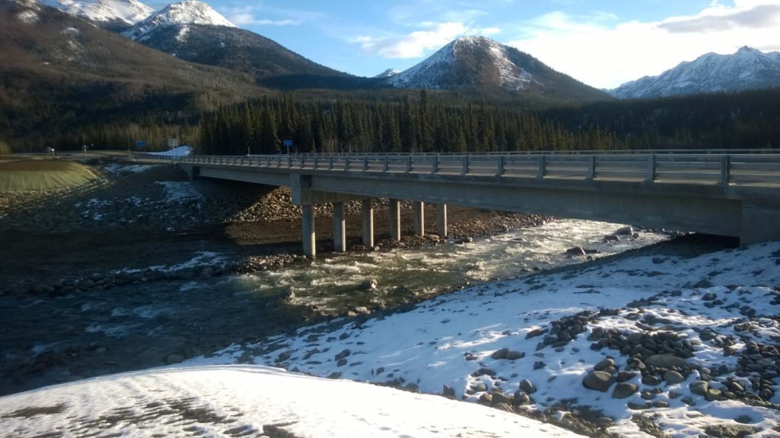
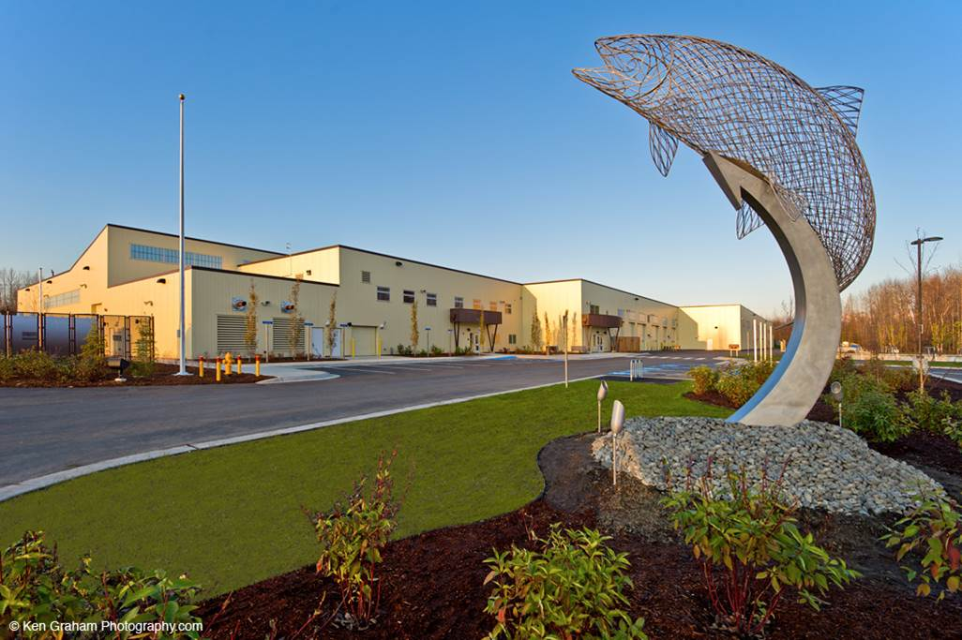
CMGC Examples
Riley Creek Bridge
William Jack Hernandez Sport Fish Hatchery
Notes:
Here are some recent examples of successful CM/GC projects completed by DOT&PF in recent years. The Riley Creek Bridge, the project crosses a seismic fault, so having the contractor involved in the design phase enabled the agency and contractor to evaluate alternatives for costs, functionality, safety and seismic stability. CM/GC also helped save a year of construction time in a state where the construction season is limited to May through September. Finally, this project was competed a year early and won the AGC project excellence award in 2015.

Slide 14
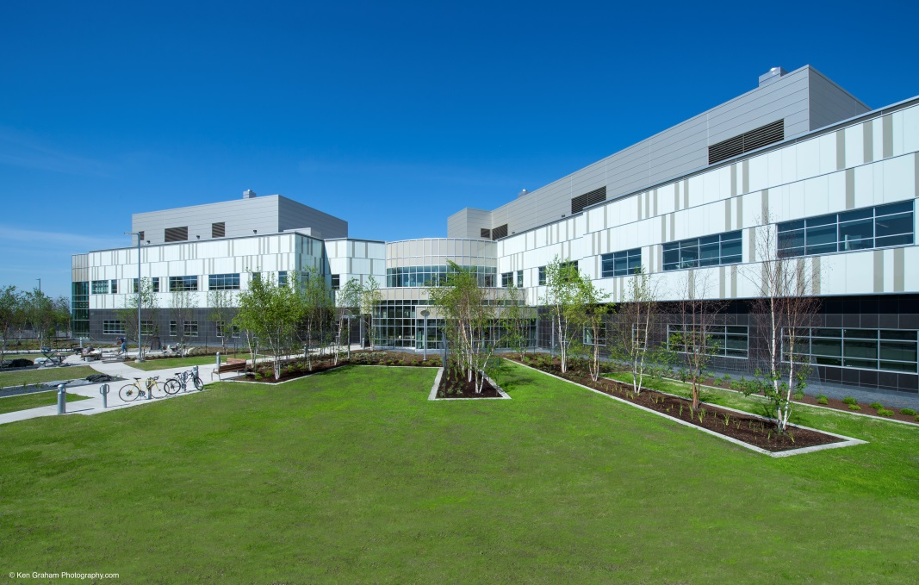
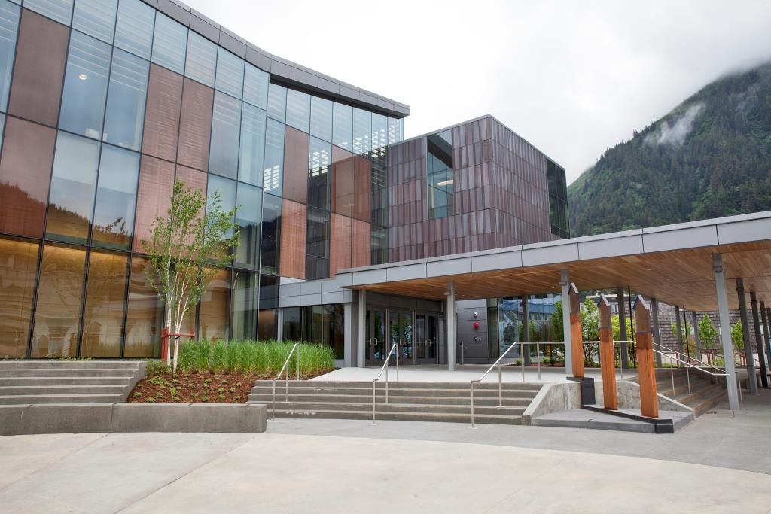
CMGC Examples
Crime Lab
Andrew P. Kashevaroff State Library & Archives Museum
Notes:
Many of the successful CM/GC project completed by DOT&PF have been vertical construction, each of which was completed on time and on budget or better. Like the Riley Creek Bridge, we are expanding to more horizontal projects like University Ave in Fairbanks and a project at MP 231 on the Parks Hwy. The two Alaska Class Ferries are also being built under a CM/GC contract with Vigor Ship Yard in Ketchikan.

Slide 15


Design Build (DB) - Process
One Contract
For Design And Construction
Procurement method where the owner enters into a contract with a single entity to provide both design and construction services
The single entity drives a unified workflow effort from initial concept to final completion
Like CMGC, this form of project delivery transforms the relationship between the owner and designer-builder into an alliance that fosters collaboration and teamwork
Owner
Single Point Responsibility
Contractor
Notes:
Design Build is another alternative procurement process DOT&PF has used successfully in recent years and a process we will be pursuing to accelerate project delivery, improve project certainty and reduce project costs in the future.
In this procurement process, the owner enters into a contract for both final design and construction with a single contractor. As noted on the slide, this process also fosters teamwork between the owner and contractor like CM/GC, improving communication and collaboration and increased transparency on project costs.

Slide 16
DB: Advantages
Compresses the time from Notice to Proceed (NTP) to project completion
  Overlaps design and construction activities - 30 – 40% quicker than conventional methods
  Shorter timeframe allows owner cradle to grave project management
Provides early cost certainty (similar to CMGC)
Environmental/Constructability issues can be forecasted during design phase
  Design Modification
  Resolve Permitting Issues

Slide 17
DB: Project Selection
Relatively simple projects:
  Do not require significant Right of Way acquisitions
  Scope is clearly defined and contains several acceptable possible solutions
  Complicated environmental permitting / process is not a factor

Slide 18
DB Examples
Northbound Glenn Highway
Bridge over Eagle River
Parks Highway Grade
Separation at Sunshine

Slide 19
Benefits of Alternative Procurement
Improved internal & external communication:
Reduced Designer level of effort on:
  Permits
  Design elements (e.g., materials sites)
  Resource agency coordination
  Traffic control
  Storm water management
  Utility coordination
Funding agency
Specialty design
Right-of-way permits in sensitive areas
Notes:
Presenter
2015-02-24 00:01:18
--------------------------------------------
Lauren.

Slide 20
Benefits of Alternative Procurement
Reduced Change Orders
Increased Cost Certainty
Construction Staging Optimized
Time Savings = $$ Savings
23/
2/ 2015
Notes:
Presenter
2015-02-24 00:01:19
--------------------------------------------
Lauren.

Slide 21
Benefits of Alternative Procurement
Knowledge transfer
Credibility and relationship with external stakeholders
Flexibility for future projects
Credibility and relationship with Contractor
Notes:
Presenter
2015-02-24 00:01:19
--------------------------------------------
Lauren.

Slide 22
Additional Considerations
Award Timing
Availability and Cost of Project Commodities
Location and Access to Utility Corridors
Material Sites – In-River Alluvial
Notes:
Award Timing – (fall, early spring) allows the owner and contractor to identify and negotiate, mitigate, or let the contract dictate the fallout of risks. A late season award (April?) for arctic construction allows no time to clarify expectations and commitments, innovate, or mitigate risks to any party.
Availability and cost of project commodities - I.e. – insulation vs. borrow vs. environmental impacts and commitments. The two active Dalton Highway projects had a mix of gravel-only and gravel-insulation in various typical sections. We were fortunate to have material sites spread throughout the project (reducing overall haul costs). For Brice (MP 397-414), the cost per mile of an insulated section of roadway was less than the gravel section. For Cruz (MP 379-397) – the relationship was swapped. Unfortunately, a roadway of greater height, also has a greater footprint. The impacts to wetlands, fish passage culverts, and other project environmental considerations made this an impossible change, post-award. The additional costs and risks associated with the environmental impacts were likely to consume the majority of the savings (and delay the start of the work for permitting changes).
Location and Access to Utility Corridors - Currently, utility installations are not done to the same care/standard/engineering considerations as the roadway. A utility installation adjacent to the roadway, that may cause thaw and settlement – and eventually a roadside “pond” – creates hazards to the public, and also restricts the location of the roadway for future widening, changes in alignment, and other factors. Placing non-transportation (private) facilities outside the ROW (or extending the ROW) would allow the department future flexibility and reduced constraints for future projects.
Material Sites - Most sites north of Atigun are terrestrial (on land, but almost always wetlands). Establishing a material site is costly in these areas (physical costs, as well as environmental mitigation), and also unsightly. The costs to access an in-river site are much less, and there is potential (currently being evaluated by UAF and DOT Hydrology) for these sites to be replenished between projects. Construction methods and environmental considerations have both improved, and the protection of fish and waterways can still be maintained in most areas.

